Slide 1



Introduction to R and RStudio
UBC Bioinformatics and Statistics Workshop Series
In-Person Host: Bioinformatics and Statistics Committee - TAHLI

Slide 2
Announcements
Are you added to our Teams?
If Yes - Great! Chat with you there!
If No - Send us an email, we’ll add you. However, if you already sent us an email, please don’t resend emails!! We’ll add you shortly.

Slide 3
Next workshop - October 22nd
Topic: Effective Plotting
Pros and Cons of different plotting techniques, choosing technique that fits best
Hybrid
In Person: UBC Department of Anesthesiology, Pharmacology & Therapeutics (APT)
Look out for more details

Slide 4
Today’s Agenda
R/Rstudio
Installing and Setting up
Integrated Development Environment interface
Sample data Analysis
Goals: Making sure you can open and start on analysis!

Slide 5
Installation links for R and RStudio
R: https://cran.r-project.org/
RStudio: https://posit.co/download/rstudio-desktop/

Slide 6
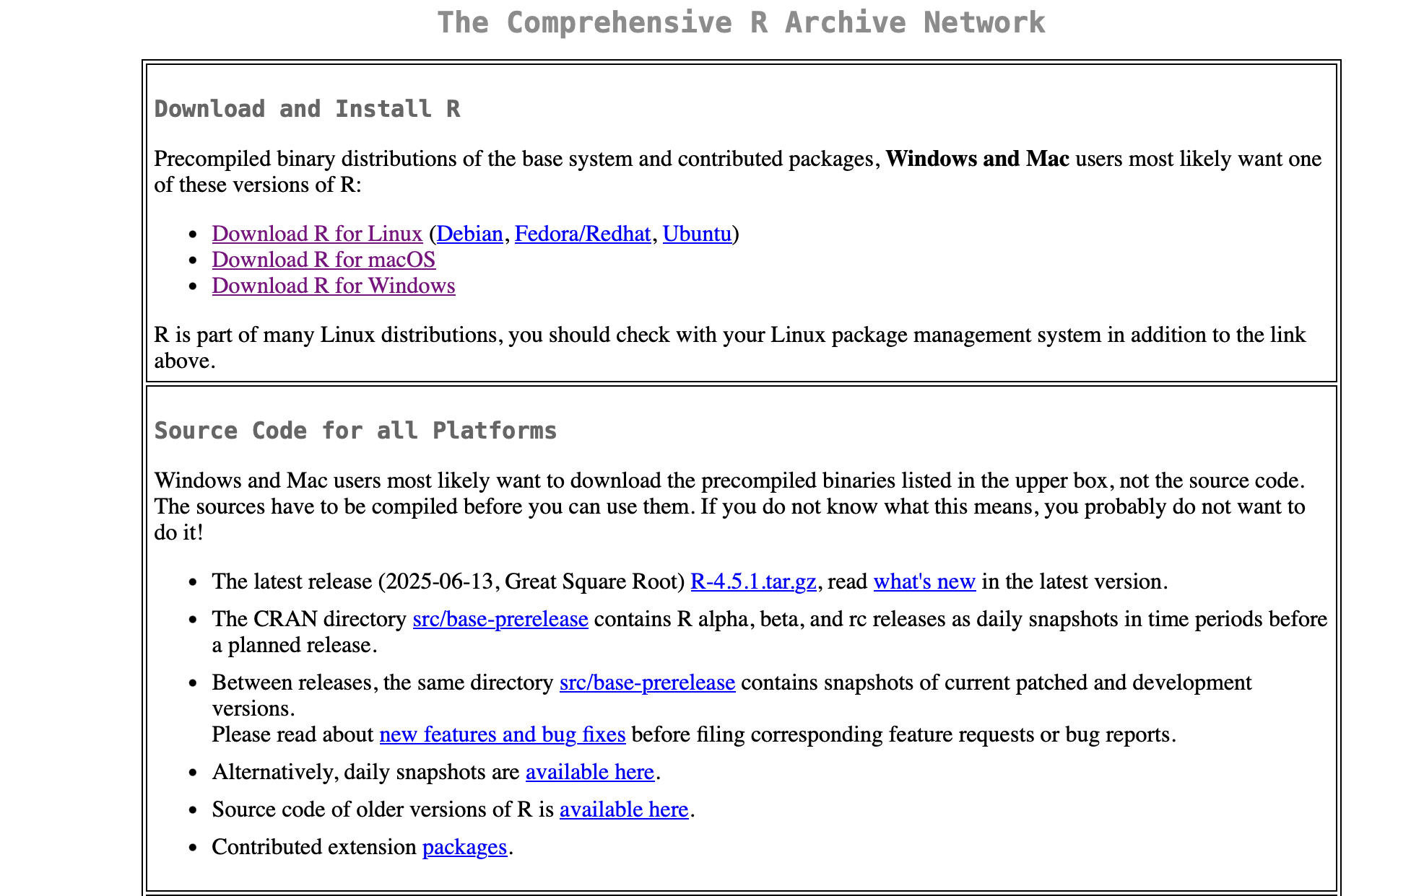
Installation R: What’s your base system?

Slide 7
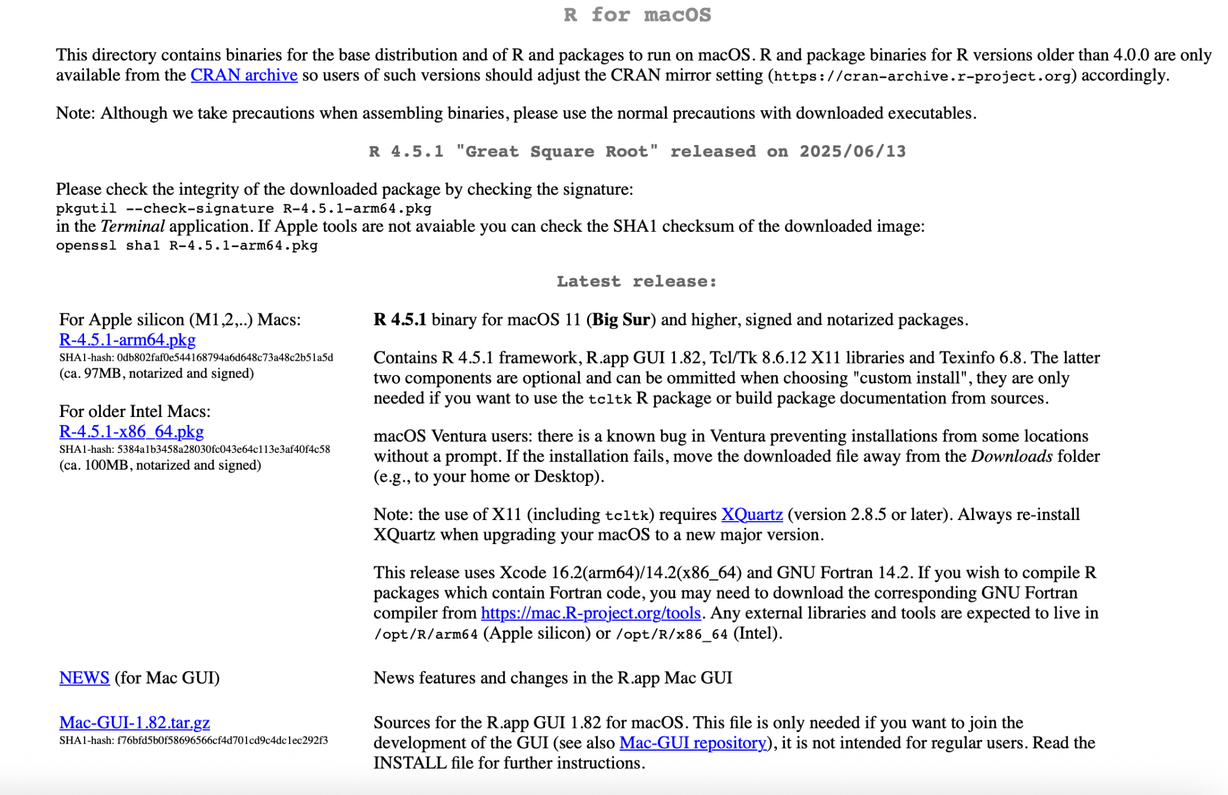
Installation for R - macOS

Slide 8
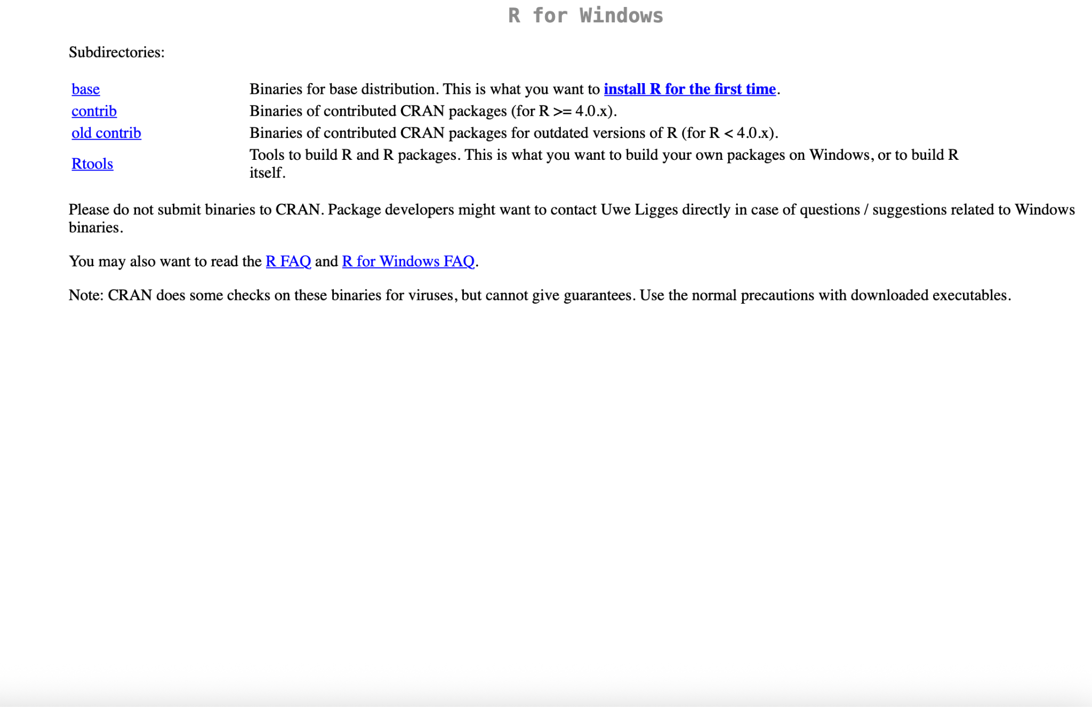
Installation for R - Windows

Slide 9
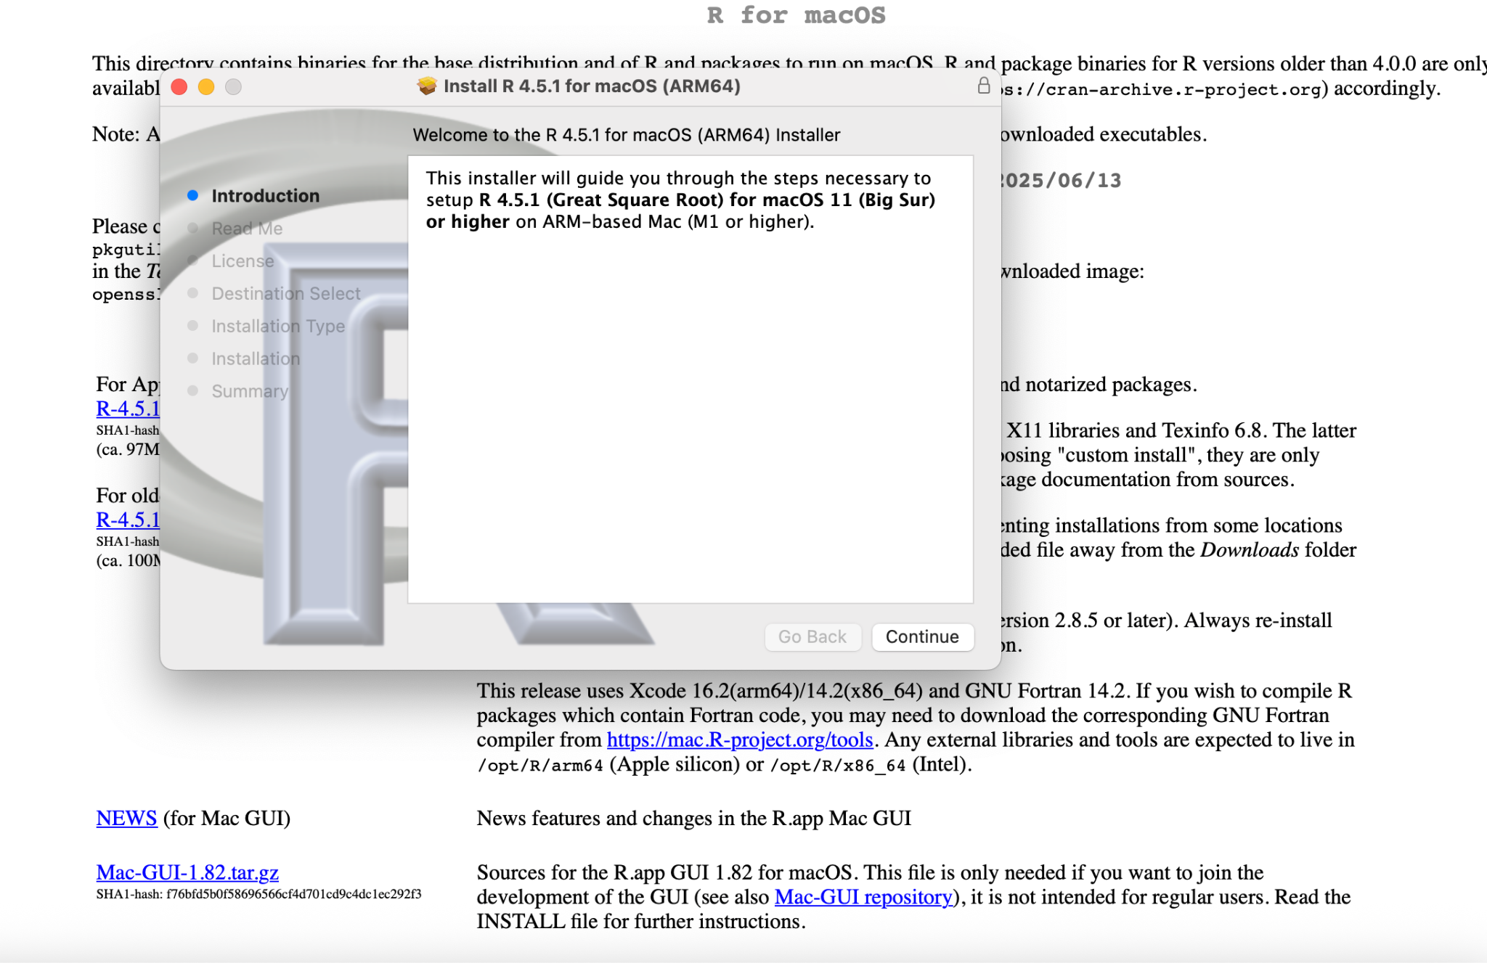
Downloading R - demo for MacOS

Slide 10
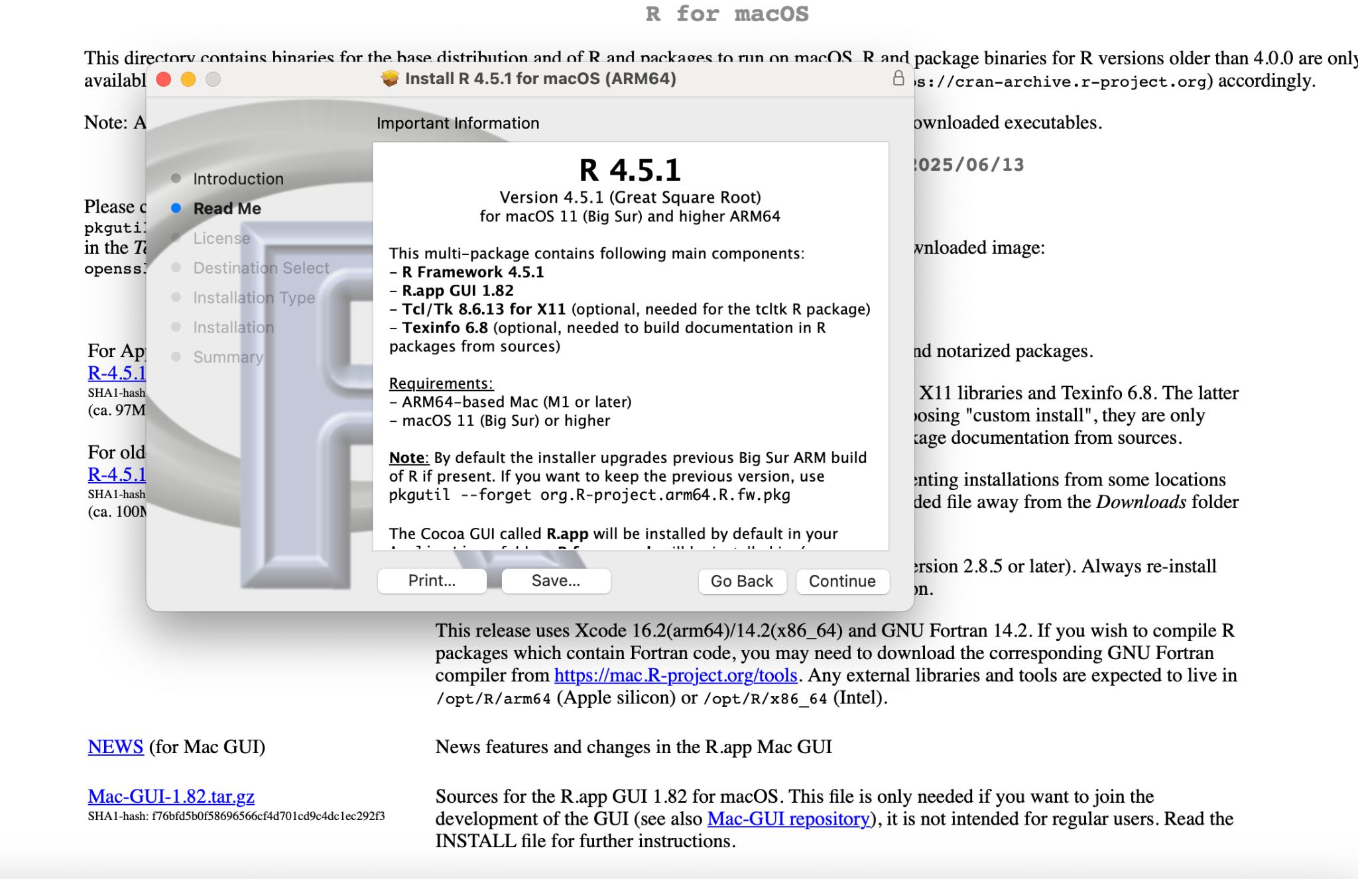
Downloading R - MacOS

Slide 11
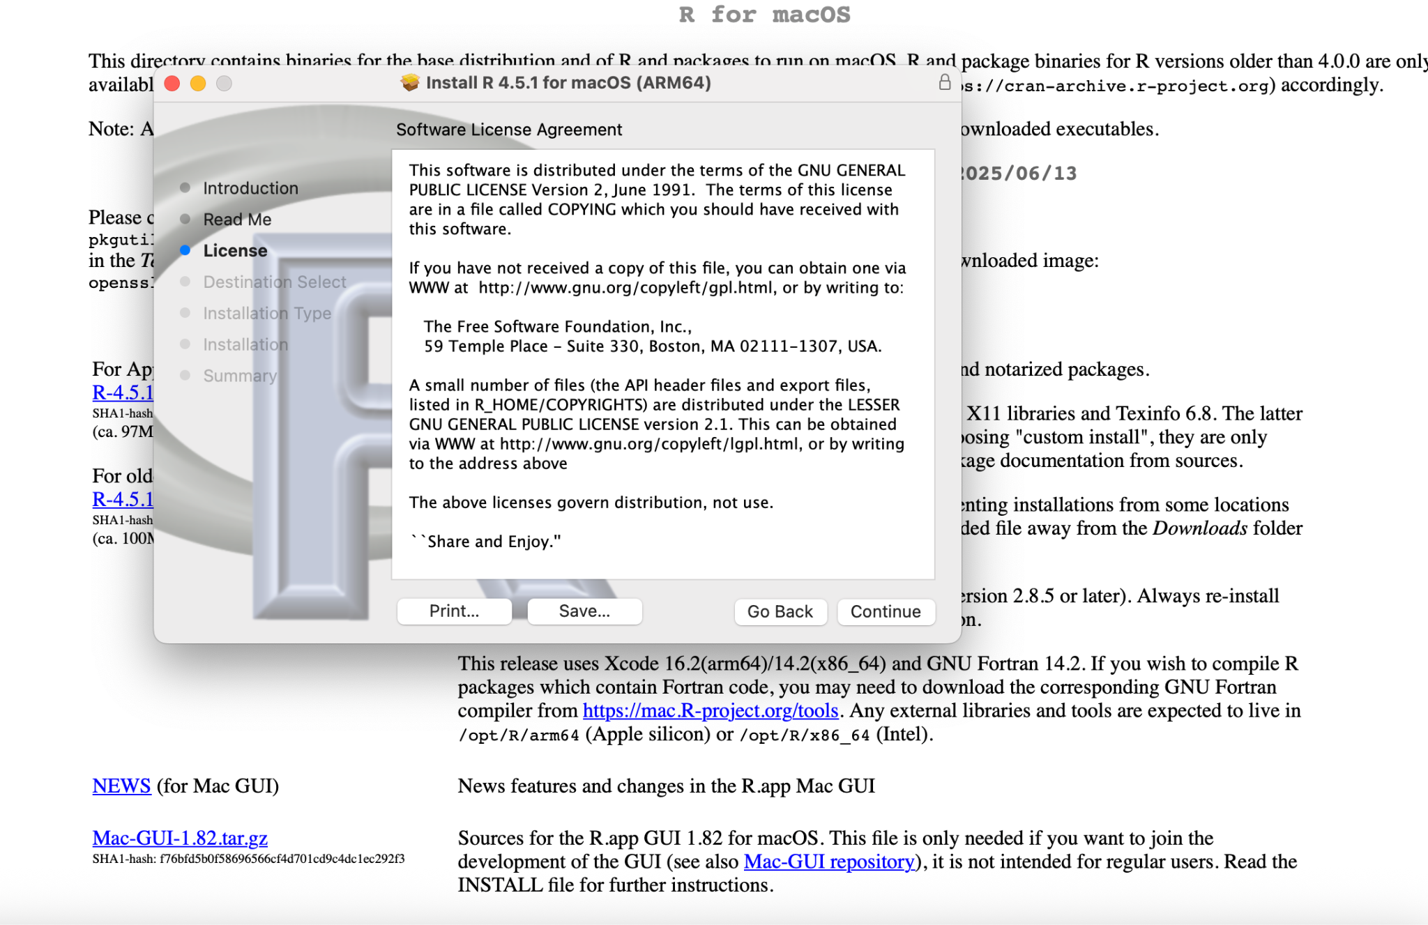
Downloading R - MacOS

Slide 12
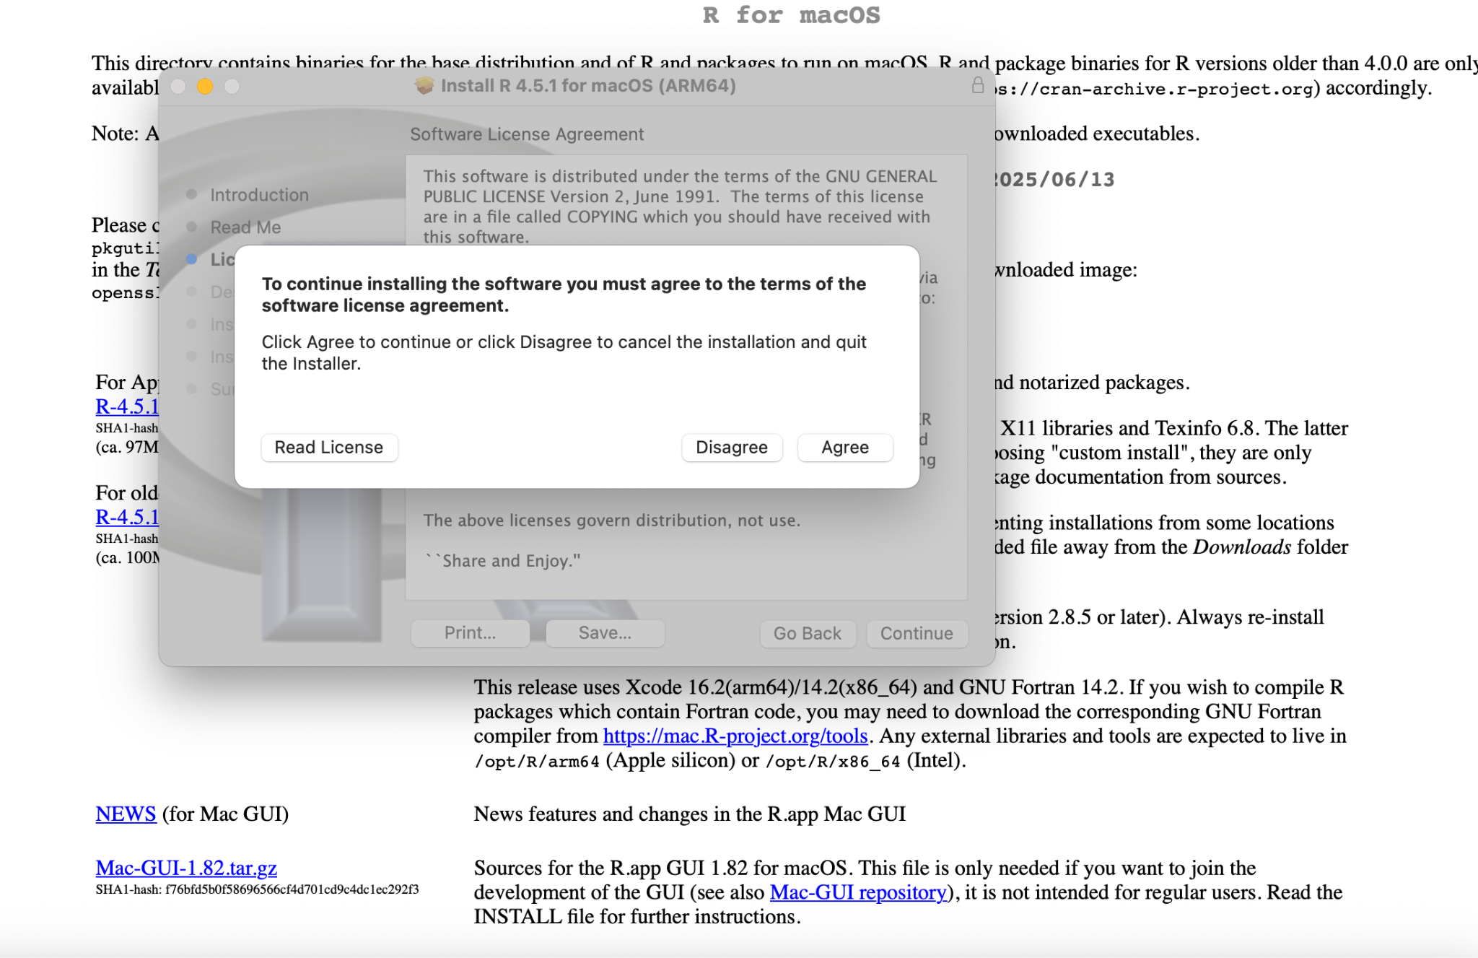
Downloading R - MacOS

Slide 13
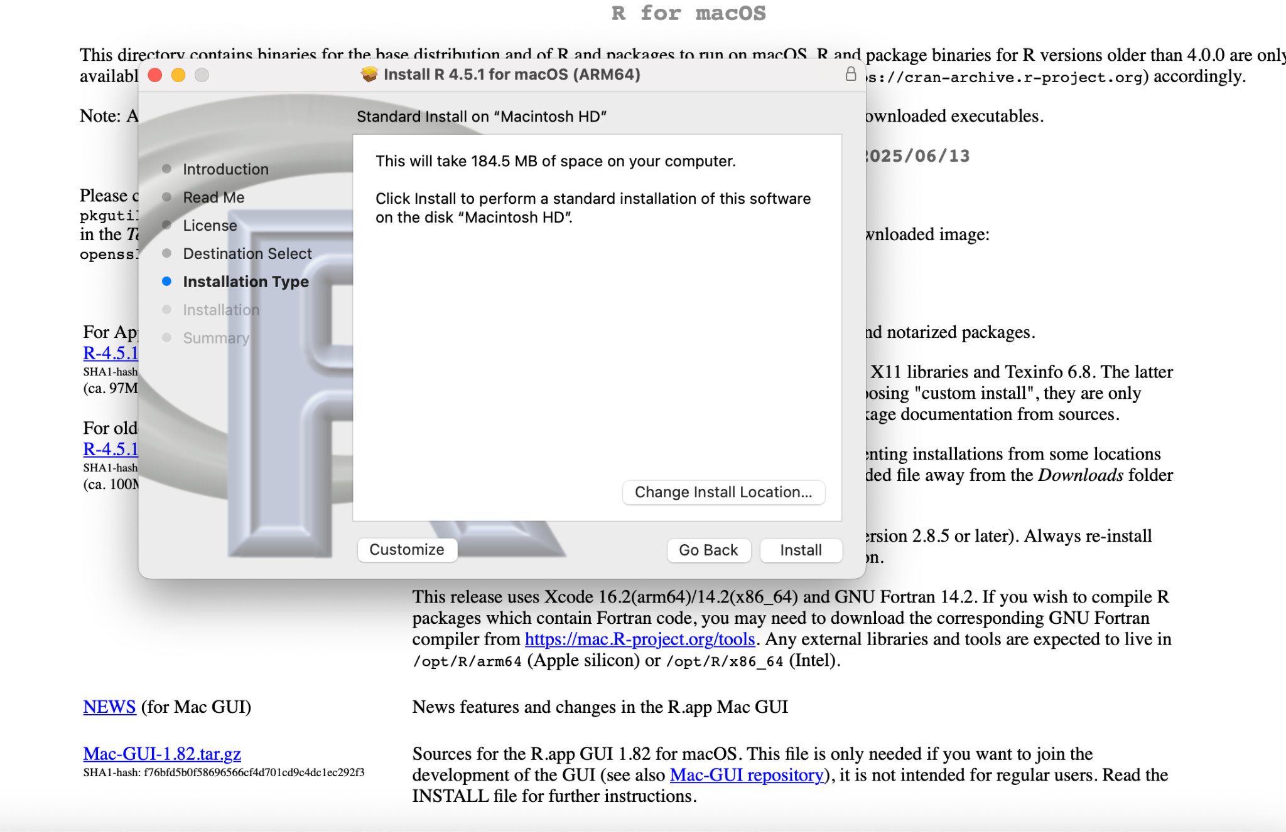
Downloading R - MacOS

Slide 14
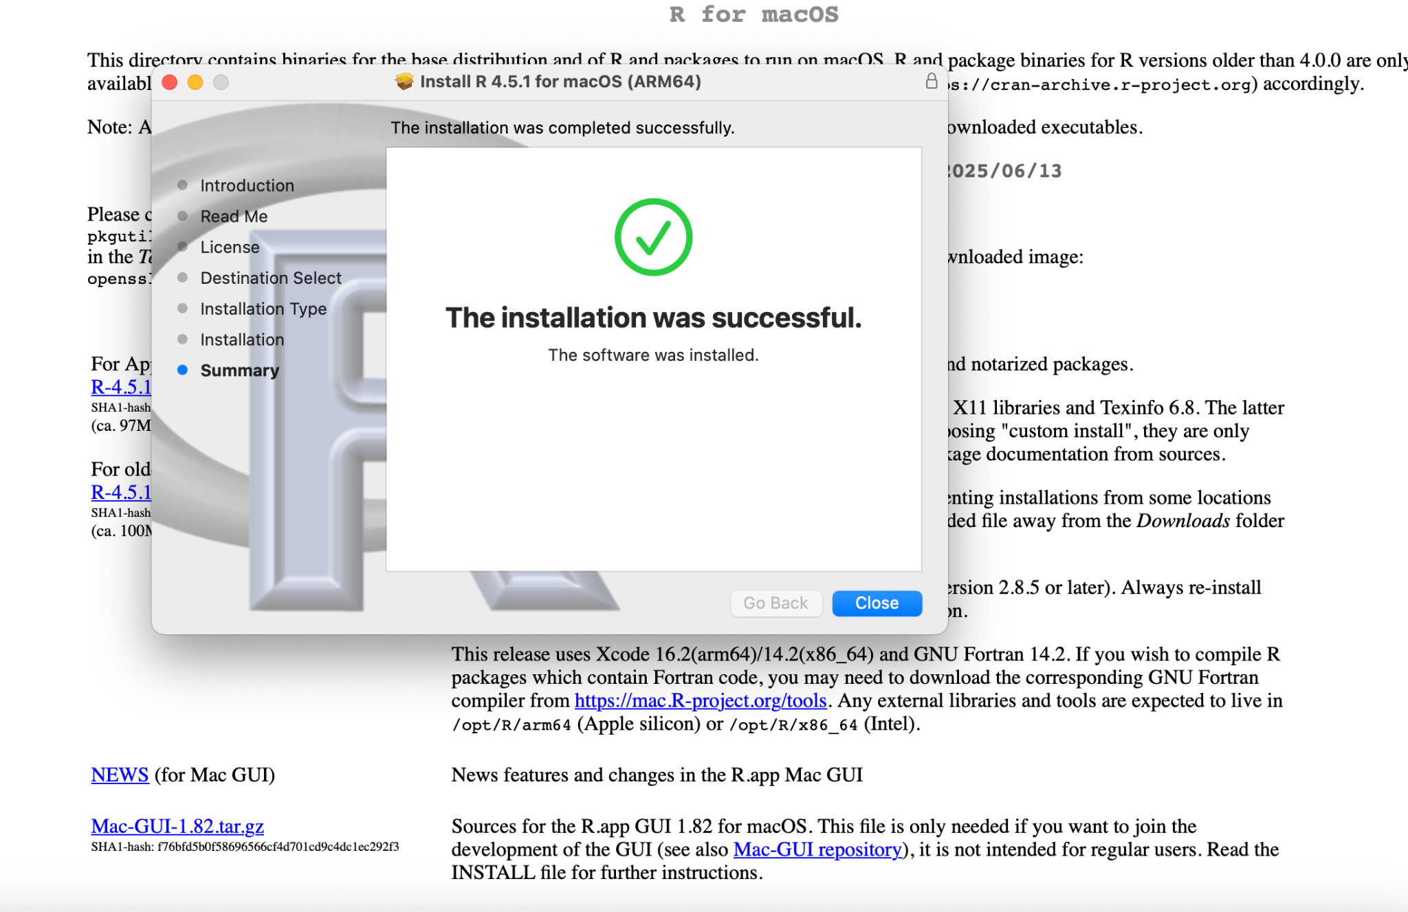
Downloading R - MacOS

Slide 15
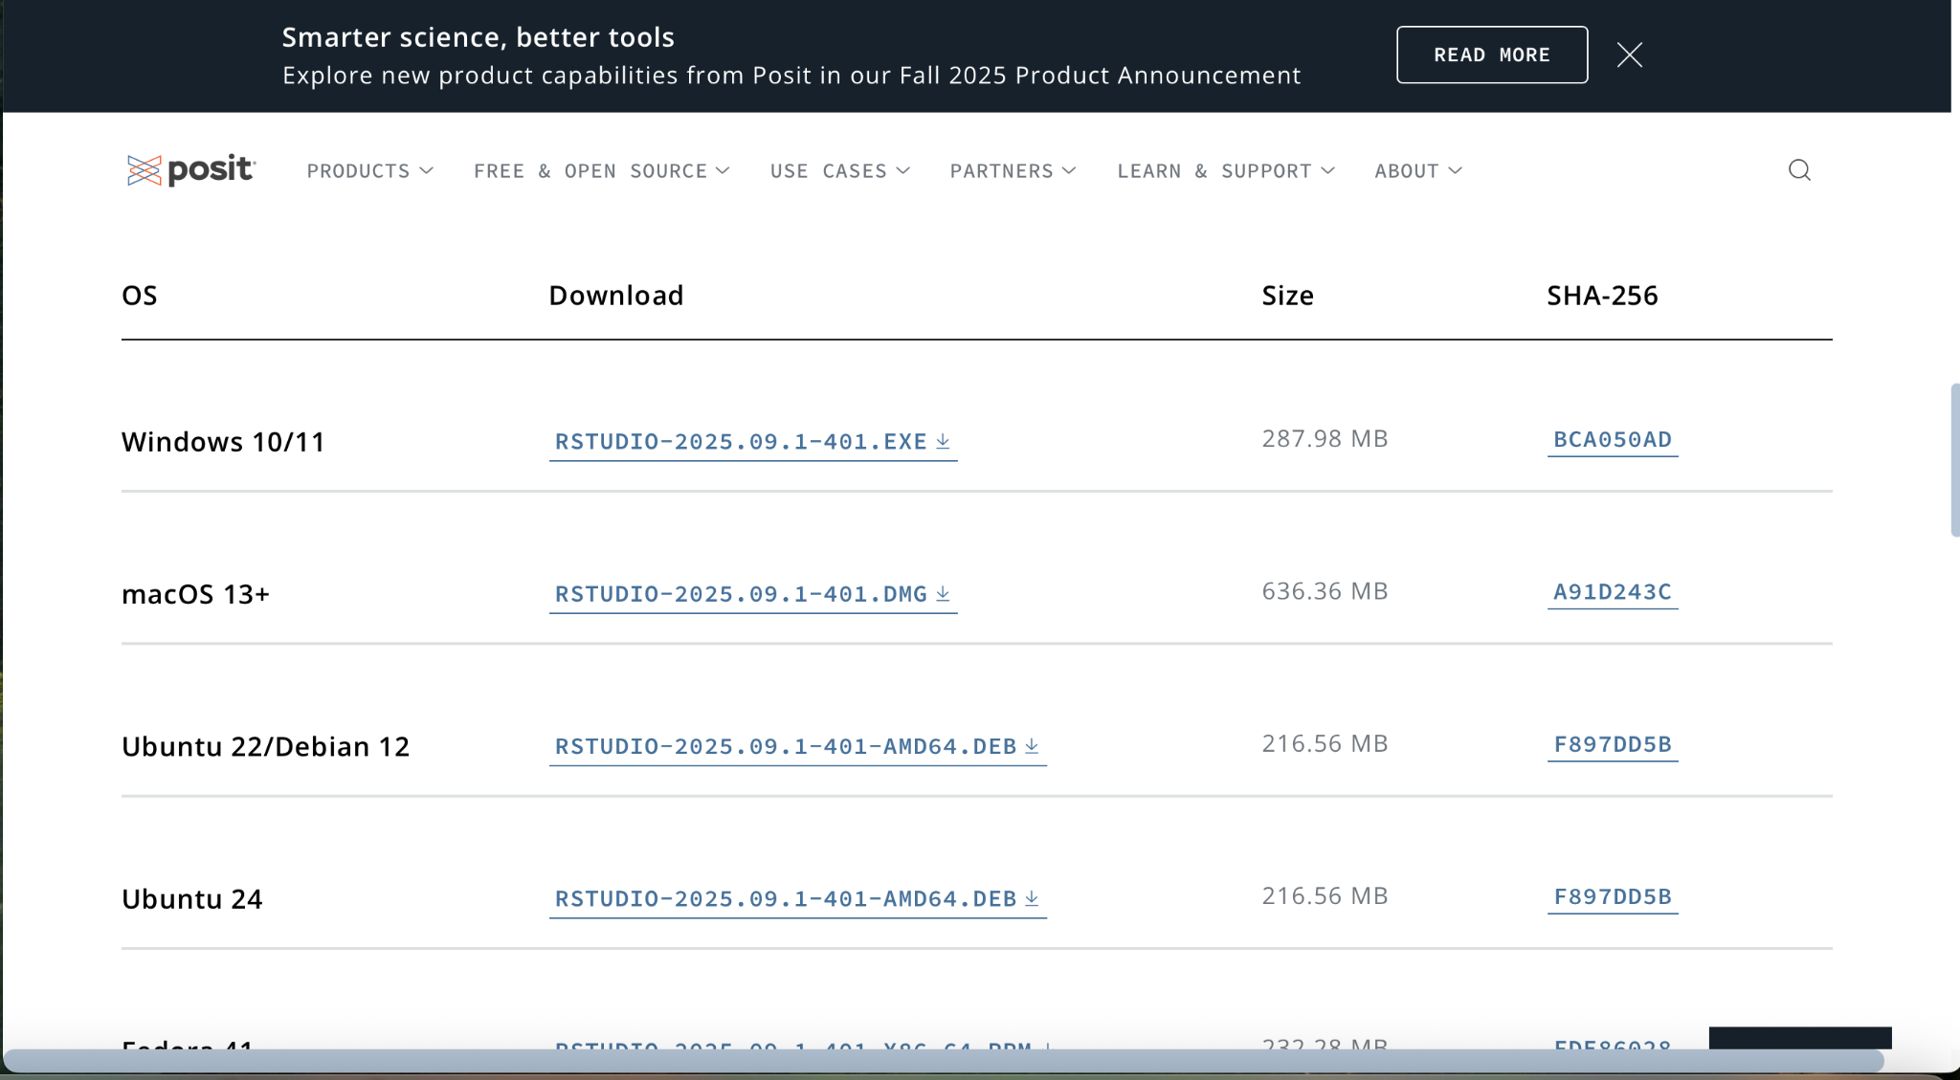
Installation for RStudio: What’s your base system?

Slide 16
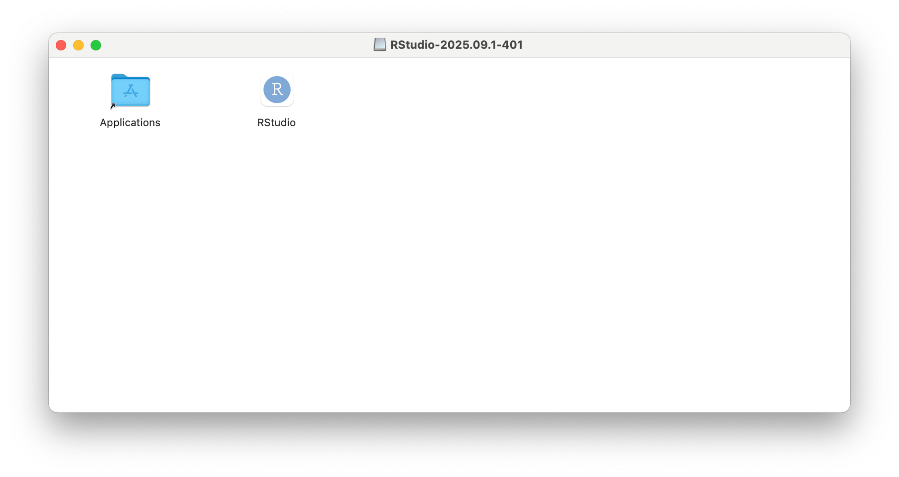
Downloading RStudio - demo for MacOS
Drag “RStudio” into “Application”

Slide 17
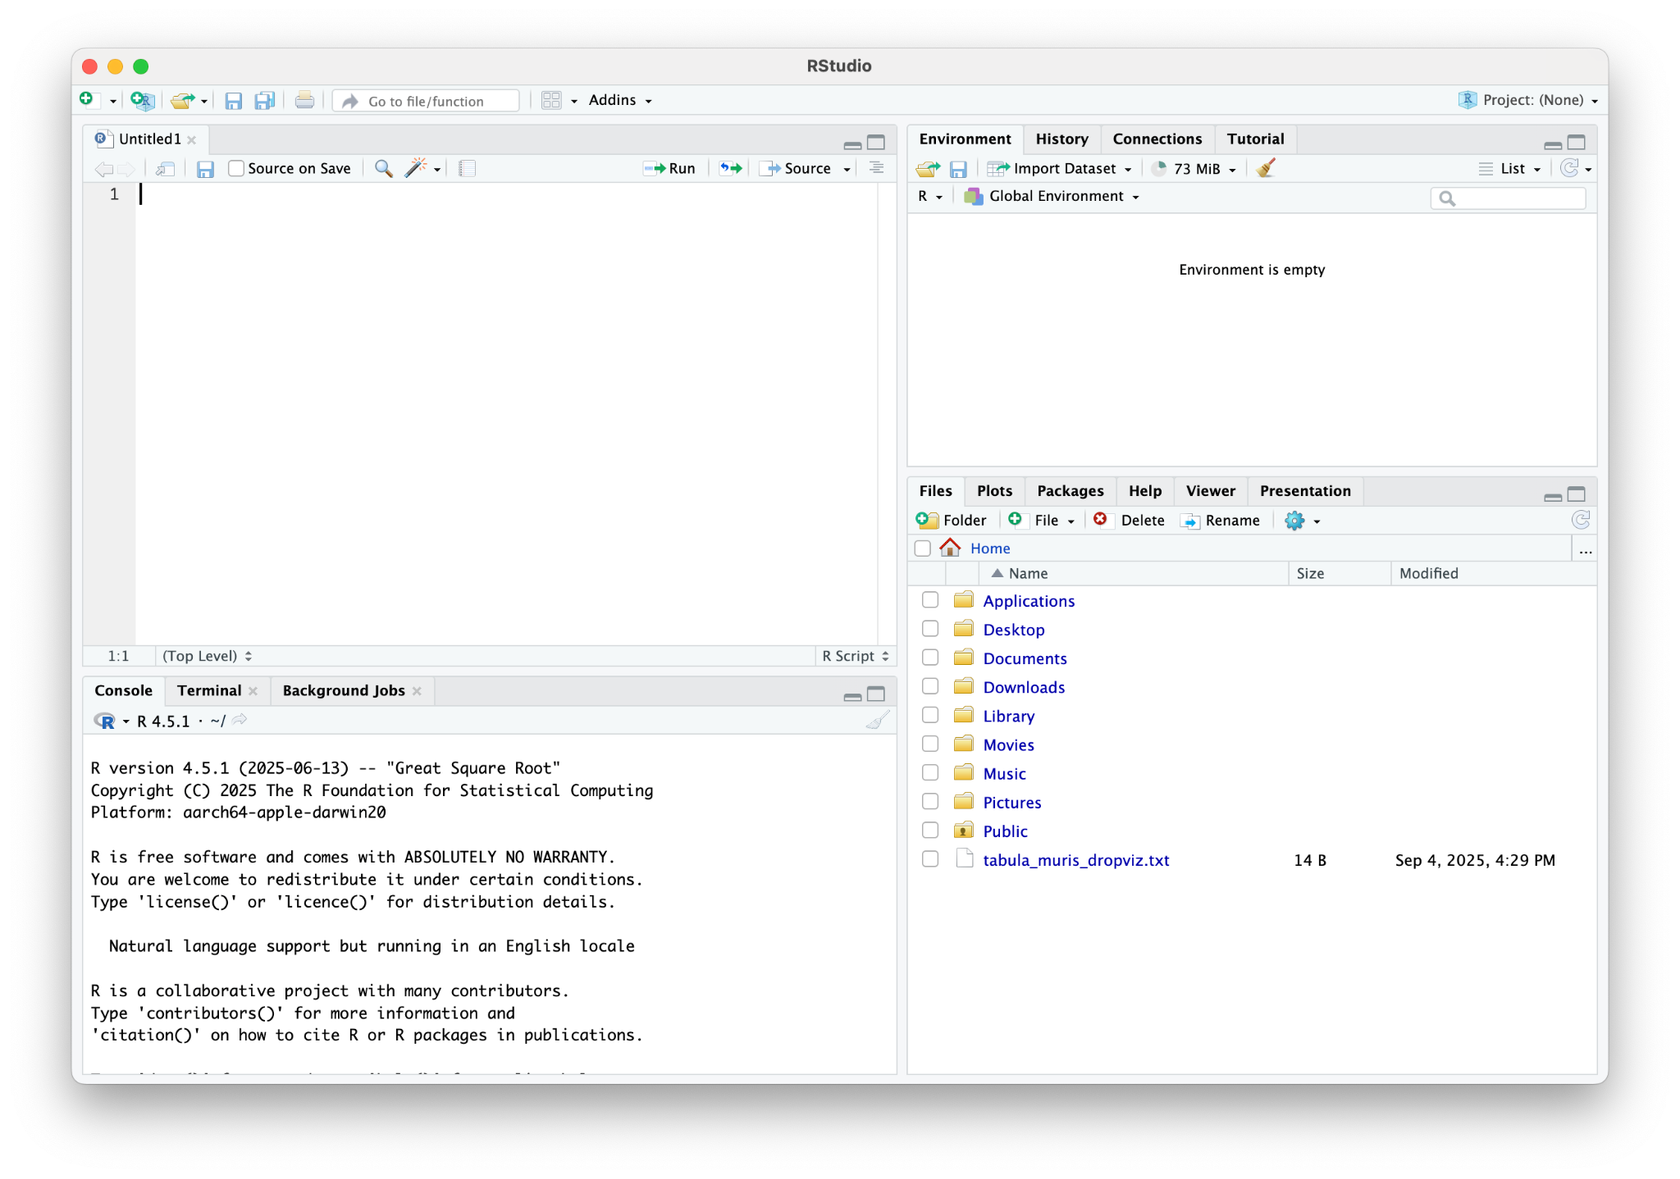
RStudio Interface

Slide 18
RStudio Interface
Source/Script Editor
Code
Write and Edit codes
Environment/History
Storing data/objects
Console
Run Code, See output/errors
Files/Plots/Help
Manage files/plots/packages

Slide 19
RStudio Interface - A Kitchen Analogy
Source/Script Editor
Code
Write and Edit codes
The recipe
Environment/History
Storing data/objects
The fridge
Console
Run Code, See output/errors
The Stove
FIles/Plots/Help
Manage files/plots/packages
The cabinets

Slide 20
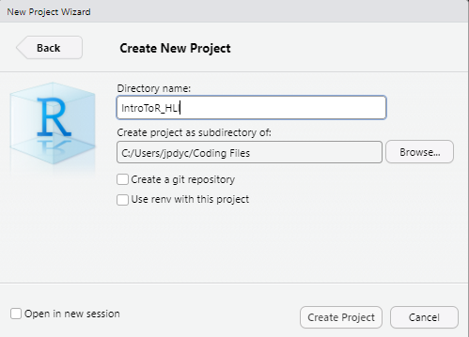
Making a new R project
File > New Project
New Directory > New Project
Make note of where your directory is!
3) Create project

Slide 21
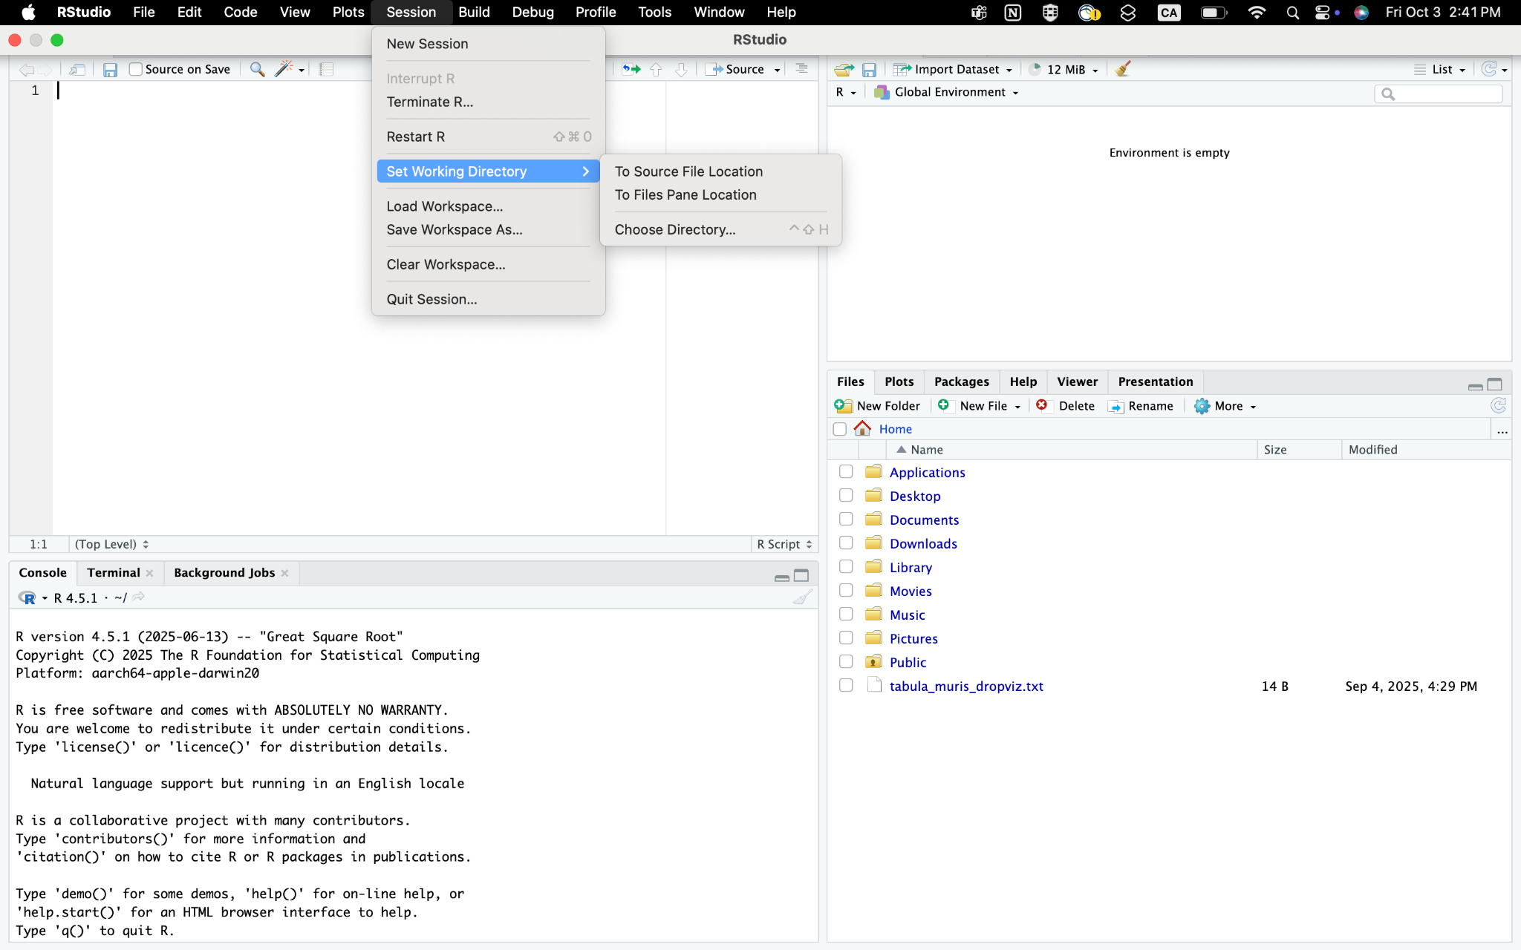
RStudio Interface - Setting working directory

Slide 22
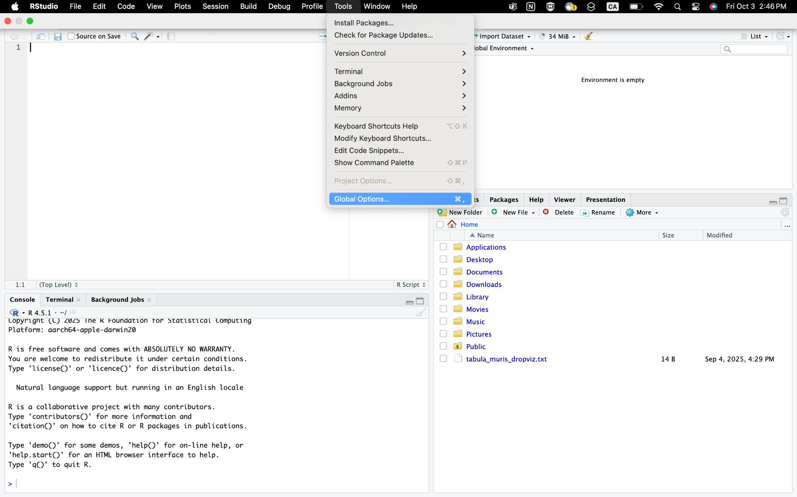
RStudio Interface - Changing theme

Slide 23
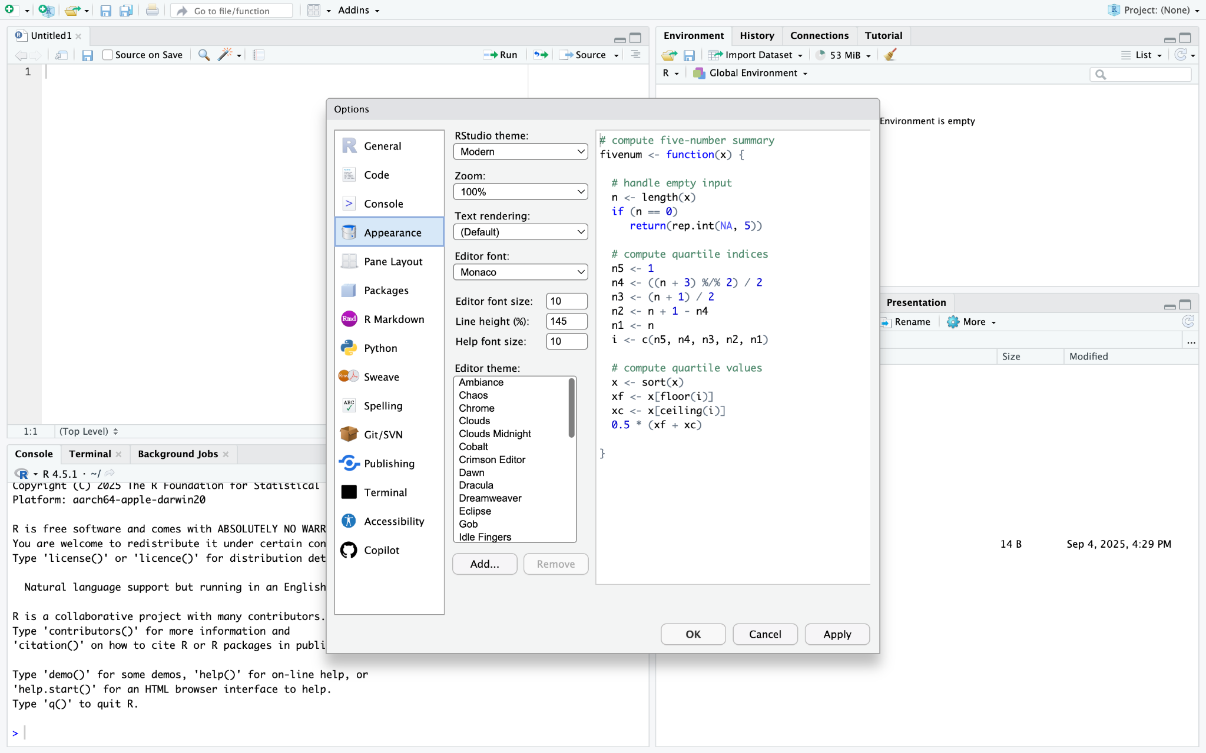
RStudio Interface - Changing theme

Slide 24
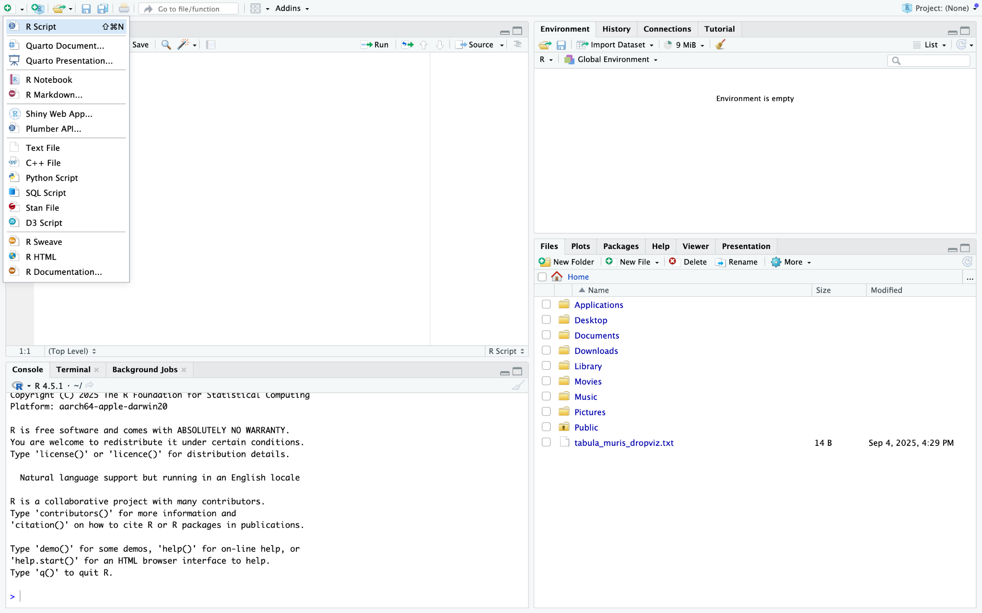
RStudio Interface - Create new files

Slide 25
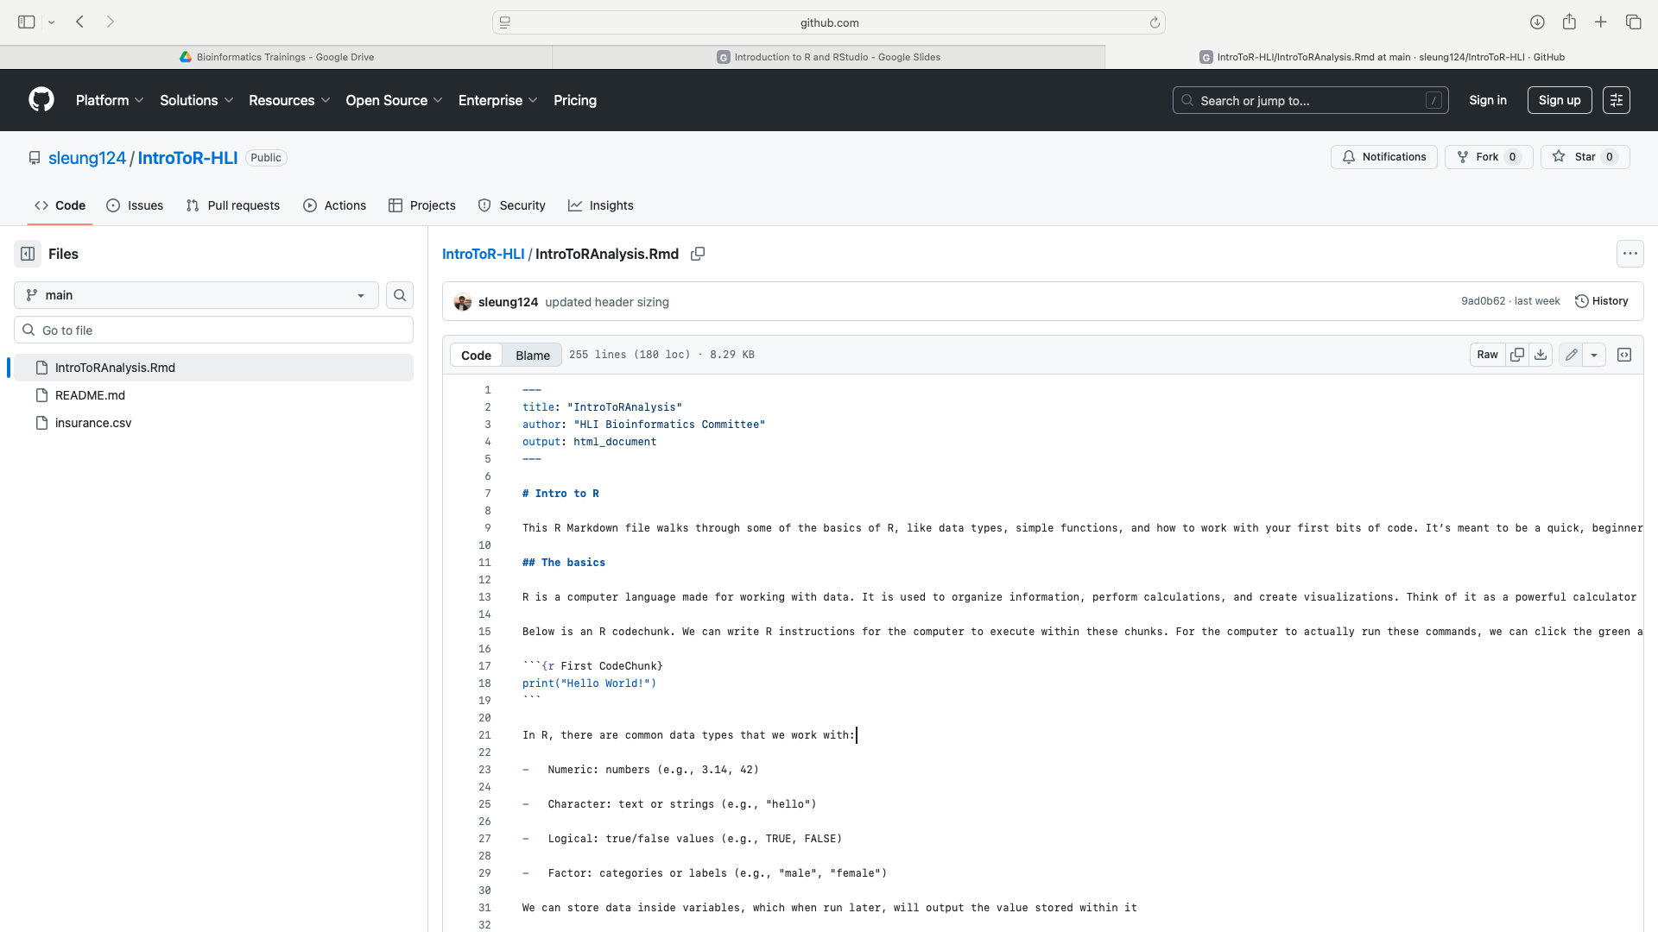
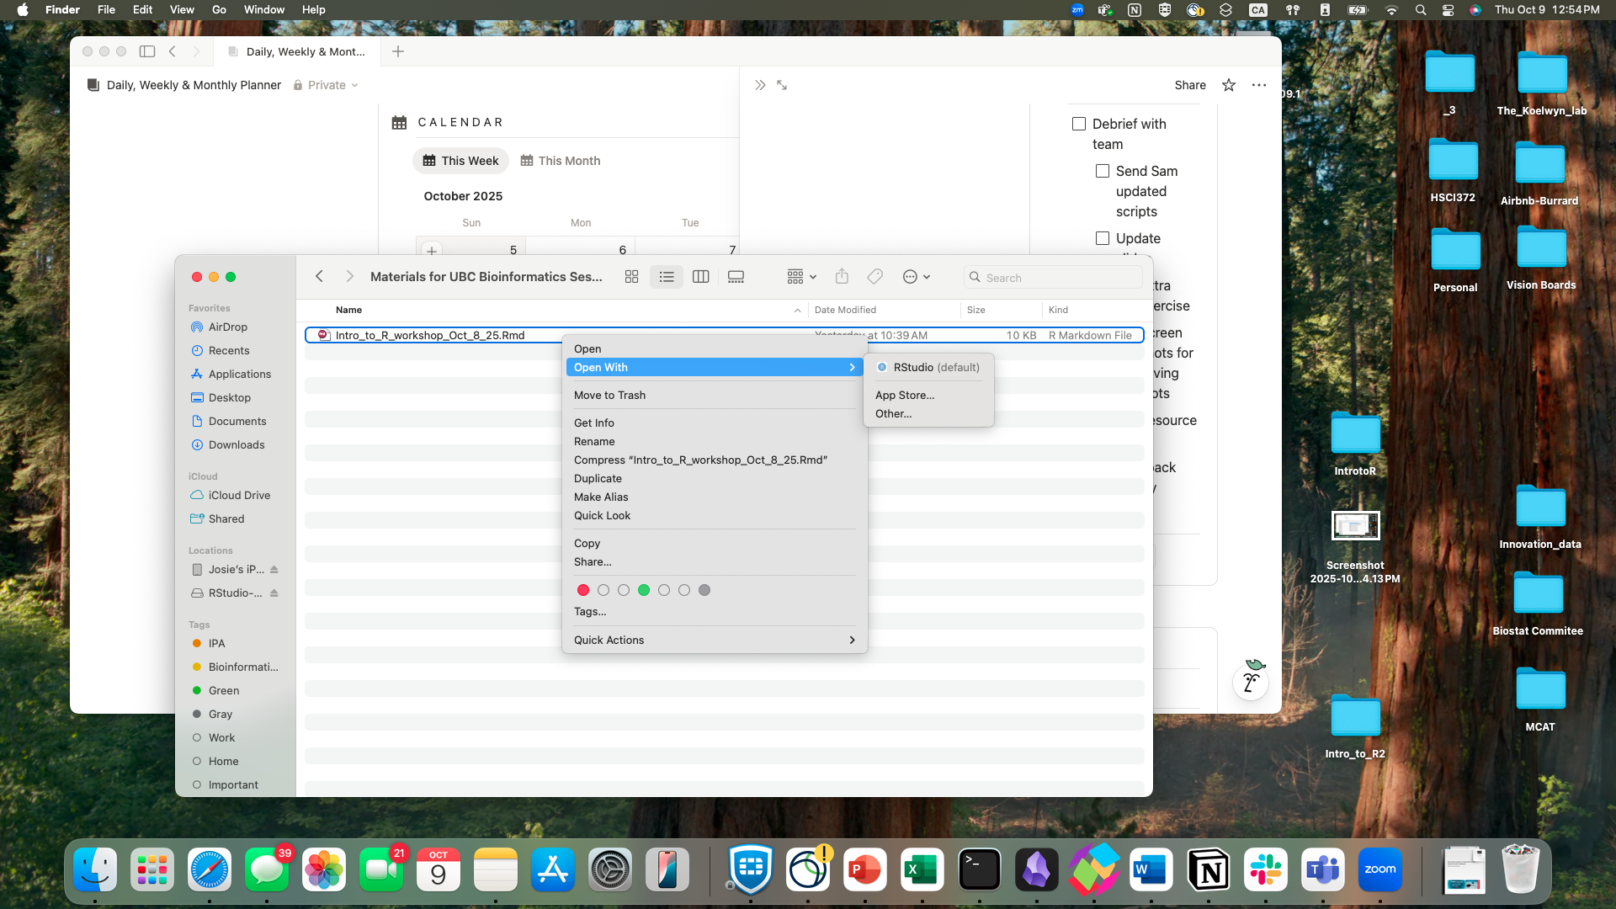
Basic syntax
R Markdown file: Open using 2 ways
Go to this link https://github.com/sleung124/IntroToR-HLI/blob/main/IntroToRAnalysis.Rmd
Click on the download icon on the top right corner
Right click on the file
Hover on “Open With”
Choose RStudio
Open from the file we sent out to you
Right click on the file
Hover on “Open With”
Choose RStudio

Slide 26
Basic syntax
More details on the RMarkdown in the #Intro to R and the #The Basics portions

Slide 27
Insurance - Sample dataset
Download dataset using one of the following ways:
From our email
From this link: https://github.com/sleung124/IntroToR-HLI/blob/main/insurance.csv
From this drive folder: https://drive.google.com/drive/u/0/folders/1qfJ1YL79r5UAME97gndUjoR2BkcrztEB
2. Make sure you know where the data is downloaded in!
Important for reading the dataset into RStudio later!

Slide 28
Insurance Cost Dataset
1339 data entries
Information of individuals (Age, Sex, BMI, Children, Smoker, Region) and their insurance cost (Charges)

Slide 29
Insurance Cost - Data exploration
Using R to answer these questions and plotting the answers:
How many unique regions are in the dataset?
What is the average age of participants in this dataset?
Which sex has more participants in the dataset?
What is the average BMI for smokers vs. non-smokers?
On average, how many children do people have?

Slide 30
Insurance Cost - Data exploration
How many unique regions are in the dataset?
Answer: 4

Slide 31
Insurance Cost - Data exploration
What is the average age of participants in this dataset?
Answer: 39.20703

Slide 32
Insurance Cost - Data exploration
Which sex has more participants in the dataset?
Answer: Male

Slide 33
Insurance Cost - Data exploration
Which sex has more participants in the dataset?
Answer: Male

Slide 34
Insurance Cost - Data exploration
What is the average BMI for smokers vs. non-smokers?
Answer:
Smokers: 30.70845
Non-Smokers: 30.6518

Slide 35
Insurance Cost - Data exploration
On average, how many children do people have?
Answer: 1.094918

Slide 36
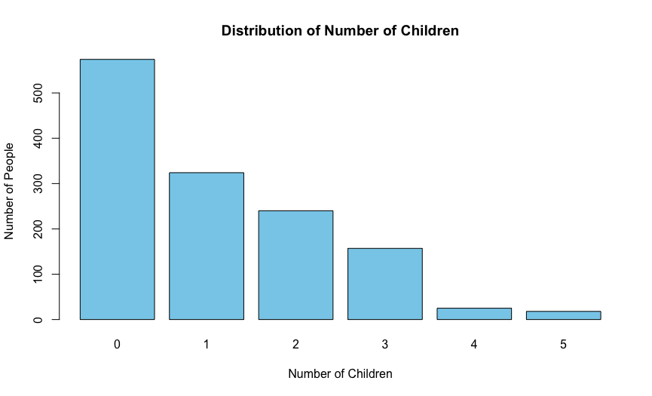
Insurance Cost - Data exploration
Bar Plot: Distribution of number of children people have

Slide 37
Summary for today’s workshop
Installing R and RStudio
RStudio interface
Setting working directory
Basic R syntax
Running codes
Saving plots

Slide 38
Goals before going to the next workshop
To make sure that you’ll have the best experience with the next workshop, here is what you should accomplish:
Open RStudio and create a new RMarkdown file
Load datafile in RStudio
Save edited file

Slide 39
Resources
Youtube sources
https://www.youtube.com/watch?v=FIrsOBy5k58
This video uses R script, instead of RMarkdown script like we did
https://www.youtube.com/watch?v=aCUM4r1ONhg
This video walks through downloading and installing R and RStudio, as well as reading in dataset
Google/ChatGPT!
These are really good at troubleshooting errors!

Slide 40
Extra practice
Load in the penguin_size dataset
Answer the questions in next slides
Note: There are codes that can give answers to the questions in the “answer slides”. However, please keep in mind that there is no 1 correct code - you can use different ways to get to the same answers! Highly encourage you to think/search/chatgpt the answer before looking at answer key provided!

Slide 41
Extra practice - questions
Direct questions: - you can find out the answer using 1 line of code.
What are the unique islands?
What are the unique species?
What is the average culmen_length?
What is the average culmen_depth?
What is the average filpper_length?
What is the average body_mass?
Elaborated questions: - you might need to use several lines of code to find the answer.
How many individual penguins per species?
How many individual penguins per islands?
How many individuals penguins per species per islands?
Average culmen_length, culmen_depth, filpper_length, and body_mass by species?
Average culmen_length, culmen_depth, filpper_length, and body_mass by islands?

Slide 42
Extra practice - Answer -
data <- read.csv(penguine_size.csv)
What are the unique islands? → Hint: unique(data$islands)
What are the unique species? → Hint: unique(data$species)
What is the average culmen_length? → Hint: mean(data$culmen_length_mm)
What is the average culmen_depth? → Hint: mean(data$culmen_depth_mm)
What is the average filpper_length? → Hint: mean(data$filpper_length_mm)
What is the average body_mass? → Hint: mean(data$body_mass_g)

Slide 43
Extra practice - Answer
How many individual penguins per species?
How many individual penguins per islands?
How many individuals penguins per specie per islands?
Average culmen_length, culmen_depth, filpper_length, and body_mass by species?
Average culmen_length, culmen_depth, filpper_length, and body_mass by islands?

